Slide 1
Keylogger project
PRESENTED BY
M.Karthisha , 3rd year Computer Science and Engineering (CSE) , Universal College of Engineering and Technology, Vallioor.

Slide 2
AGENDA
Keyloggers
Keyloggers diagram
Type of keylogger
Keylogger used
Keylogger illegal vs legal
Problem Statement
Result
Conclusion
Reference

Slide 3
Keyloggers:
A keylogger is a type of software or hardware device that is designed to record every keystroke made on a computer or mobile device. Keyloggers can be installed deliberately by an attacker to monitor a user's activities, capture sensitive information such as passwords, credit card numbers, or personal messages. They can also be used for legitimate purposes such as monitoring employee activity on company computers or parental control.
Keyloggers can operate at various levels of the computer's operating system. Some keyloggers function at the software level, where they install themselves within the operating system and capture keystrokes before they are even displayed on the screen. Others operate at the hardware level, which involves physically attaching a device to the computer's keyboard or USB port to intercept keystrokes.

Slide 4
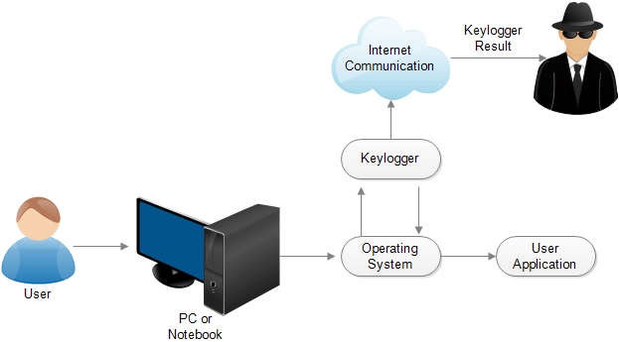
Keyloggers Diagram

Slide 5
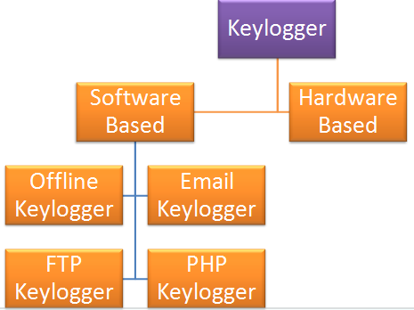
TYPES OF KEYLOGGERS
There are two types of keyloggers: hardware keyloggers and software keyloggers. The two types of keyloggers differ by the way that they log a keystroke. Both types of keyloggers can be used for malicious purposes, including credential theft and identity theft.

Slide 6
Keyloggers used
Monitoring Employee Activity: Employers may use keyloggers to monitor employees' computer usage to ensure productivity, prevent data breaches, or investigate misconduct.
Parental Control: Parents may use keyloggers to monitor their children's online activities, including websites visited and messages sent, to protect them from inappropriate content or online predators.
Law Enforcement and Intelligence Gathering: Law enforcement agencies and intelligence organizations may use keyloggers as part of their investigations to gather evidence against suspects or monitor potential threats.
Information Security Auditing: Keyloggers can be used by information security professionals to test the security of systems and networks, identify vulnerabilities, and assess the effectiveness of security measures.
Recovering Lost Data: Keyloggers can sometimes be used to recover lost or accidentally deleted text by capturing keystrokes as they are typed.

Slide 7
Keyloggers illegal vs legal
While keylogging tools are not necessarily illegal, they are often used illegally by cybercriminals , identity thieves , or other malicious actors to surreptitiously steal information or track activity without someone’s consent

Slide 8
Problem statement
The proliferation of keyloggers presents a significant challenge to cybersecurity, privacy, and data protection. These covert software or hardware tools clandestinely record keystrokes on computing devices, compromising sensitive information such as passwords, financial credentials, and personal communications. This poses a threat to individuals, businesses, and organizations alike, leading to potential identity theft, fraud, espionage, and privacy violations. Addressing the issue of keyloggers requires robust cybersecurity measures, user education, and legal frameworks to safeguard against their illicit use and protect digital privacy and security.

Slide 9
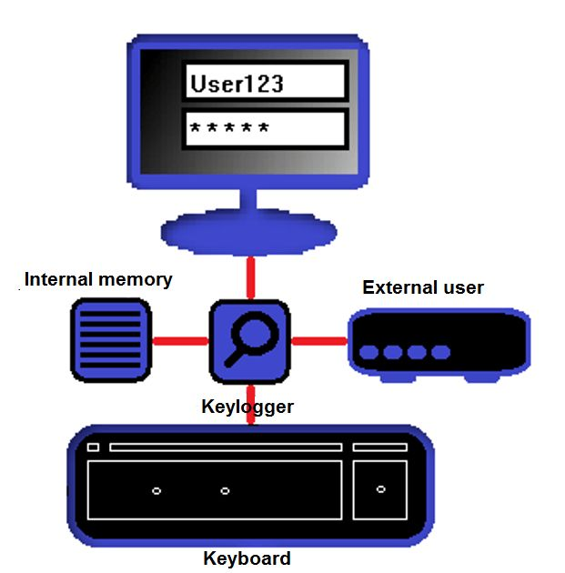
result

Slide 10
Conclusion
Keyloggers are sophisticated tools that can access not only the platform, but also the user's private information like their name, password, pin, card and bank statement. While some keyloggers are utilized in a legal manner, the creators of many keyloggers do so unlawfully. The most frequent keylogger types and strategies used to hide themselves while subverting a user's PC were examined in this study. In addition, we looked at the present situation of keyloggers and the methods through which they spread Finally, we looked into existing detection methods and made some recommendations for prevention.

Slide 11
reference
1.Use of legal software products for computer monitoring, keylogger.org.
2 V. W. Berninger (Ed., 2012), Past, present, and future contributions of
cognitive writing research to cognitive psychology. New York/Sussex: Taylor
& Francis. ISBN 9781848729636.
3 John Leyden (2000-12-06). "Mafia trial to test FBI spying tactics: Keystroke
logging used to spy on mob suspect using PGP". The Register. Retrieved
2009-04-19.
4 Andrew Kelly (2010-09-10). "Cracking Passwords using Keyboard Acoustics
and Language Modeling".
5 Sarah Young (14 September 2005). "Researchers recover typed text using
audio recording of keystrokes". UC Berkeley NewsCenter.

Slide 12
THANK YOU

